Slide 1
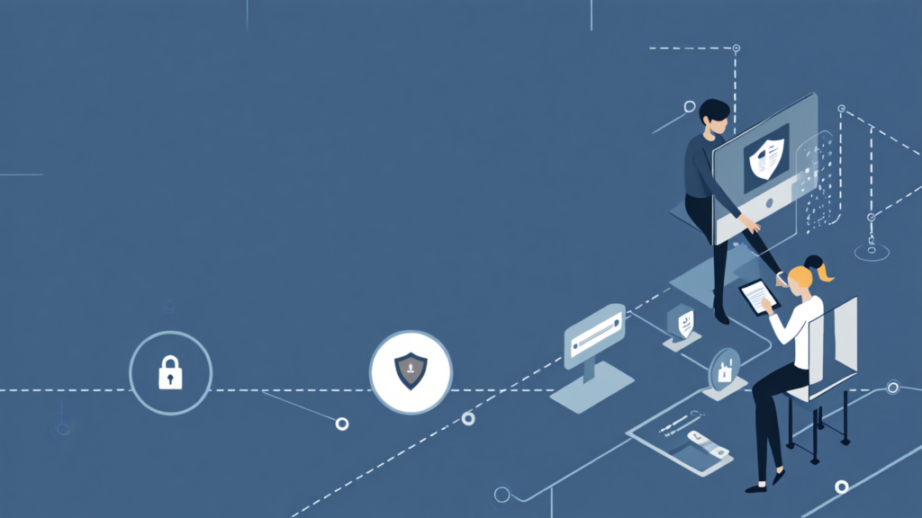
CYBERPULSE
Empowering Digital Safety in Our Communities
A Community-Driven Cybersecurity App for Everyone

Slide 2


Empowering Safe Browsing with CyberPulse
CyberPulse is designed to assist novice internet users in identifying and verifying suspicious online resources. This helps enhance digital safety, educate users, and foster a community-driven approach to cybersecurity awareness and protection.

Slide 3



Key Features of CyberPulse: Empowering Users
01
02
03
WHOIS Analysis provides detailed insights into domain ownership and registration information for safer browsing.
Phishing Detection alerts users to potential scams in emails and links, ensuring greater online protection.
Cyber Safety Quizzes engage users in learning about online threats, boosting their cybersecurity awareness and skills.

Slide 4



Students Facing Cybersecurity Threats
Empowering students to recognize online dangers
As students increasingly rely on digital platforms, they become vulnerable to cyber scams. CyberPulse aims to educate and empower students, helping them identify threats and fostering a community that prioritizes online safety through shared knowledge and resources.

Slide 5
Future Enhancements for CyberPulse
01
02
03
04
IMEI Tracking will enhance device security by enabling users to monitor their devices' locations.
Group Accounts will allow families to manage and protect multiple users under one plan.
Enhanced Phishing Tools will offer advanced detection methods to combat evolving online threats effectively.
Community Involvement will encourage user participation in reporting scams and sharing safety tips.

Slide 6


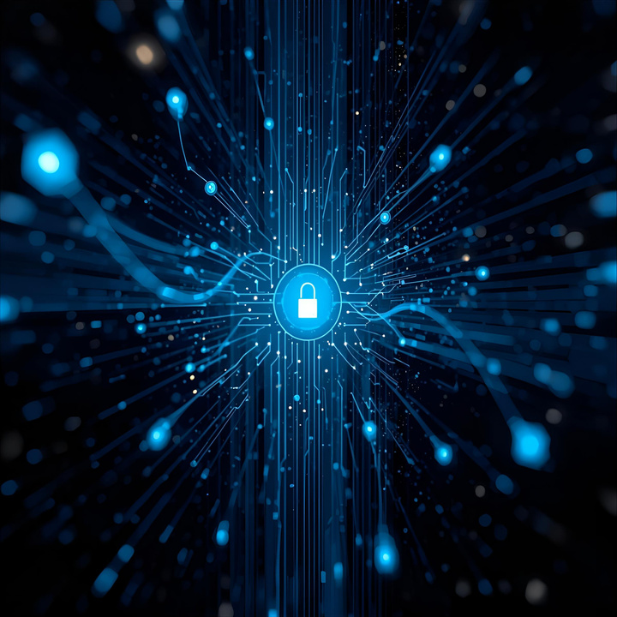

Meet the Ciphernova Team
Ntokozo
Vane
Lead Developer focused on creating secure and user-friendly features for CyberPulse.
UI/UX Designer dedicated to enhancing user experience and interface for seamless interactions.
Nigel
Taku
Integration engineer responsible for ensuring the seamless connectivity of the application components.
Community Outreach specialist working to educate users and foster a safer online environment.

Slide 7


“The best defense against phishing is awareness. Stay informed, stay safe, and empower yourself with knowledge to navigate the digital world securely.”
– Cybersecurity Expert

Slide 8


Join us for a CyberPulse Q&A!
We’d love your insights—let's empower our community together!

